Slide 1

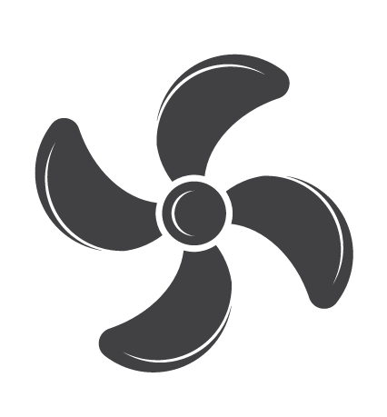
G
G

Slide 2
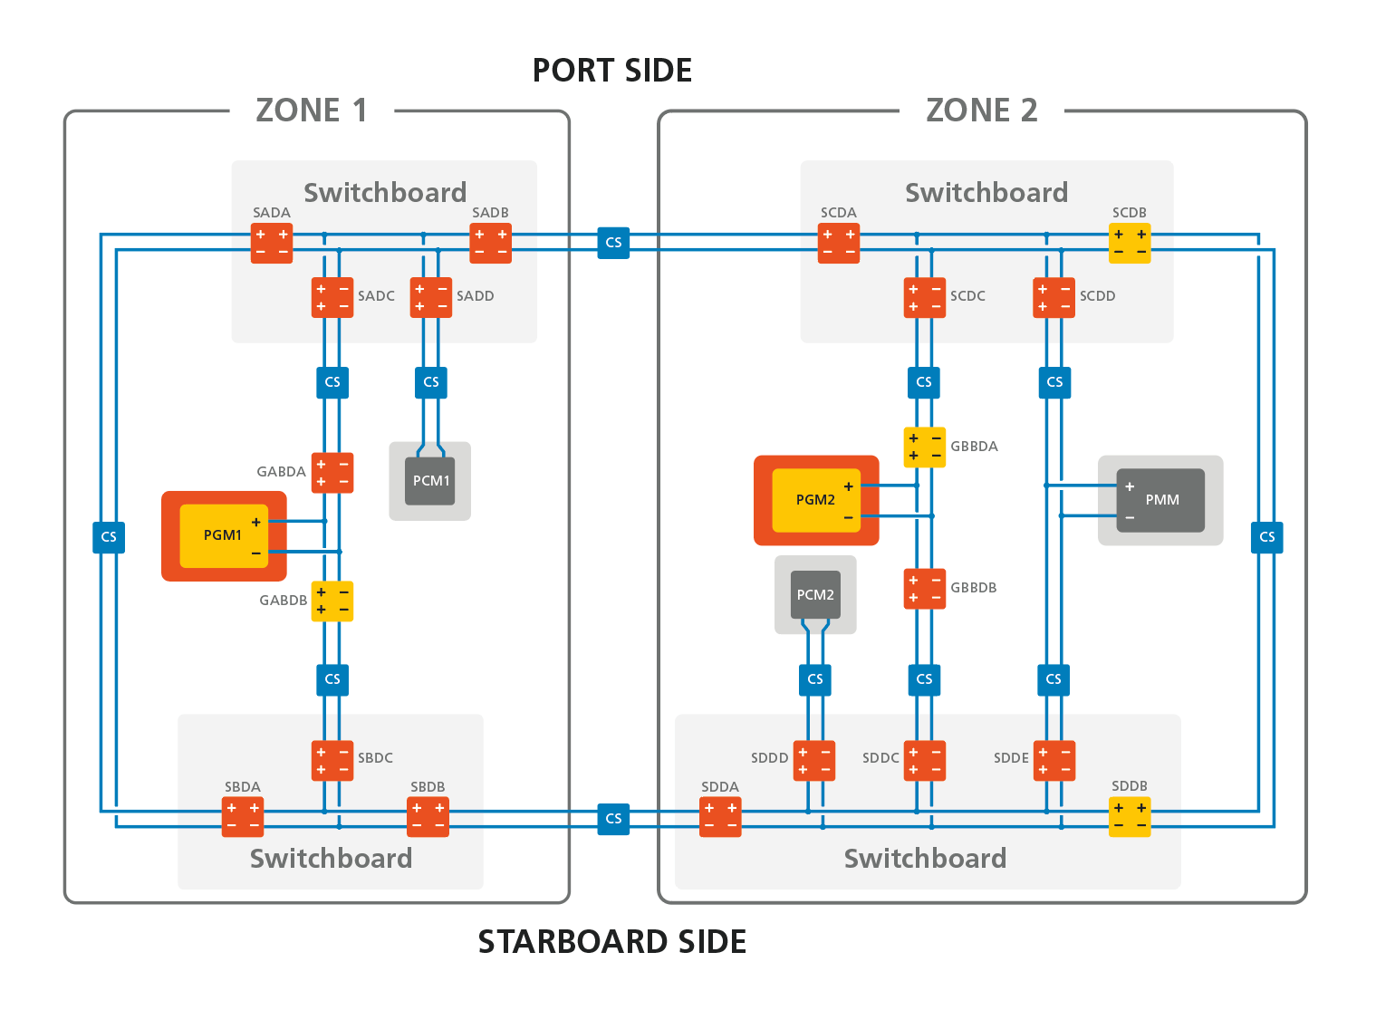

Slide 3
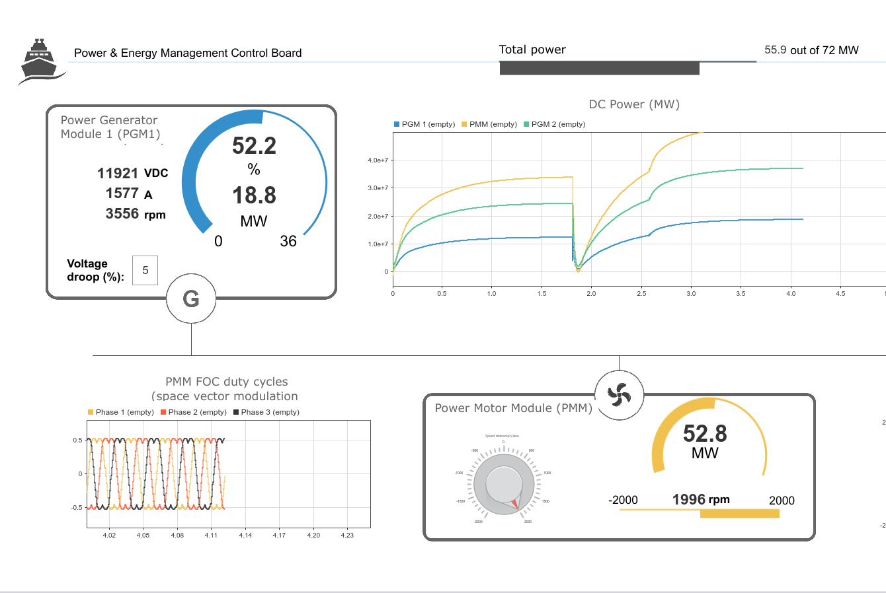

Slide 4
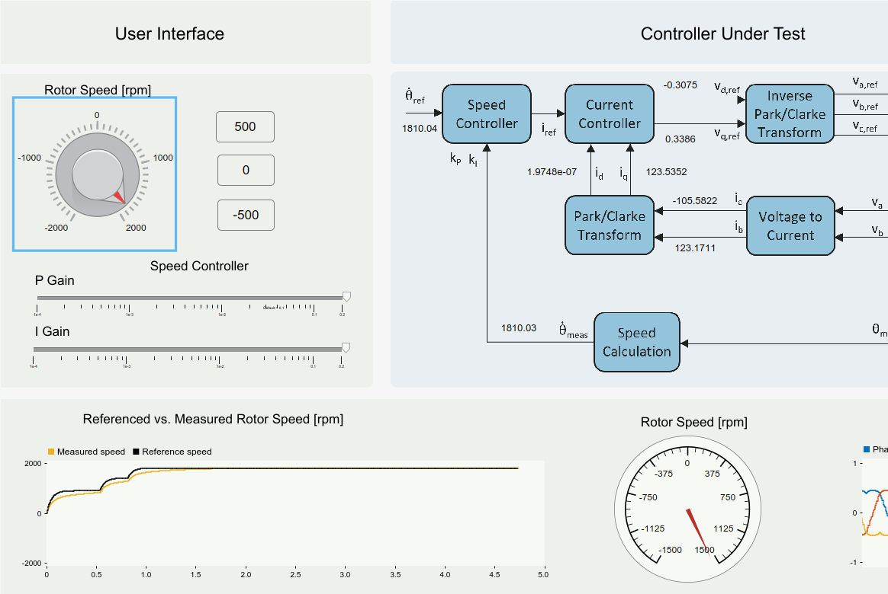

Slide 5
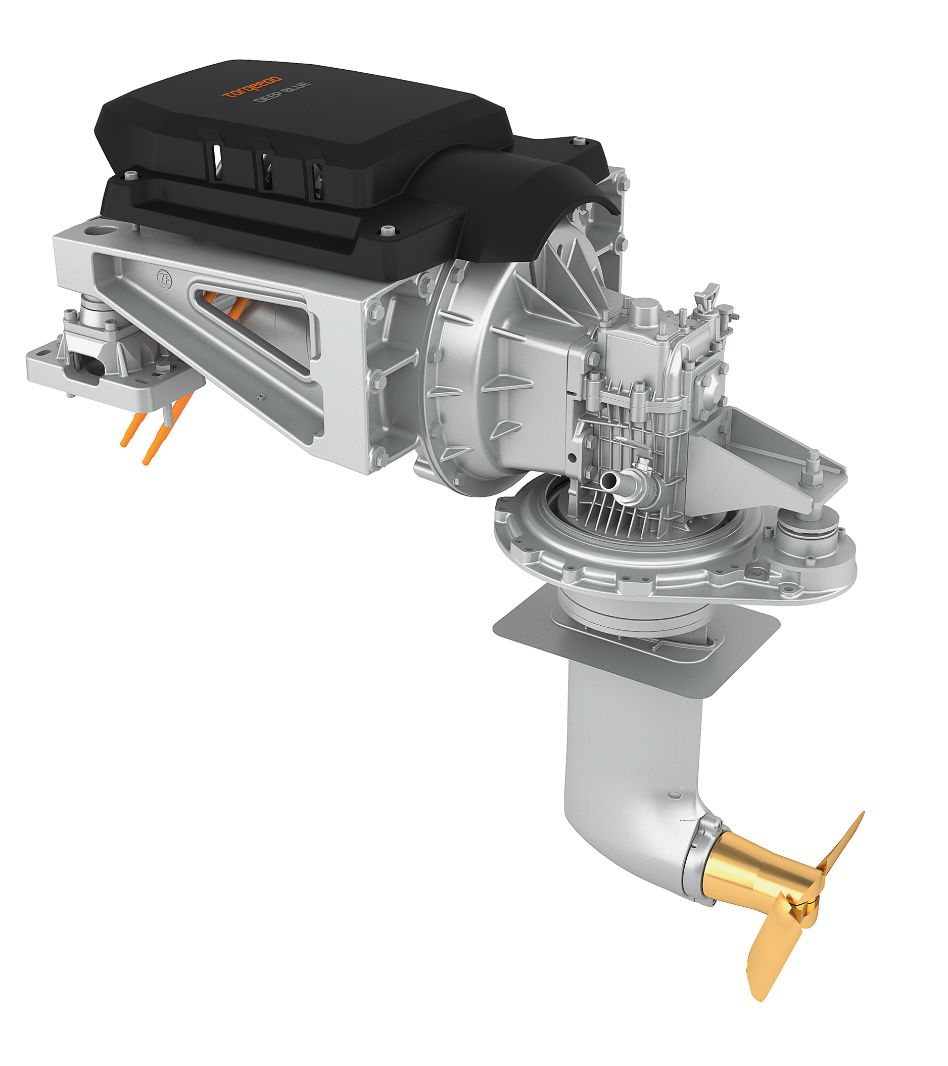


$\dot{θ}$_{ref}
v_{d,ref}
v_{a,ref}
g_{a}
Speed Controller
Current Controller
Inverse
Park/Clarke
Transform
v_{b,ref}
PWM
Generation
g_{b}
i_{ref}
v_{q,ref}
v_{c,ref}
g_{c}
k_{P}
k_{I}
i_{d}
i_{q}
Park/Clarke
Transform
i_{a}
Voltage to Current
v_{a}
Analog
Input
v_{a}
i_{b}
v_{b}
v_{b}
$\dot{θ}$_{meas}
Speed
Calculation
θ_{meas}
Quadrature
Decoder
A
B

